Slide 1
CREATIVE BRIEF

Slide 2
VIDEO PRODUCTION CREATIVE BRIEF
1. OVERVIEW
Here you put the big picture for your project. What previous experience and/or projects relate to this current one?
2. OBJECTIVES
TANGIBLE GOAL #1
What will this campaign accomplish? Give us some details here.
TANGIBLE GOAL #2
What’s your idea of success for the project? This is a key question to ask client
TANGIBLE GOAL #3
What is your desire video length?
3. TARGET AUDIENCE
Know the audience cold. You should include demographic information such as age, gender, race, and income level.
Be sure to point one key piece of information as it relates to your project.
4. COMPETITOR
Who is your company competing with? What is the marketplace like for your company ?
Be sure to give names or links (if you can find them!)
5. MESSAGE
What is the theme and message of your project?
6. TONE
Paired with the message, explain what your project will be like--funny, sincere, scary?

Slide 3
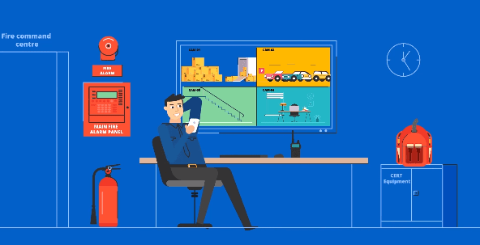
VIDEO PRODUCTION CREATIVE BRIEF
7. VISUALS
What will the project look like? What types of images or sequences will we see?
It’s a nice touch to put some inspiration on the creative brief.

Slide 4
AHS SECTION
1. SCHEDULING
We will give you a brief roadmap of what production will look like and what’s the process to meet your deadline.
2. BUDGET
What are the financials going to look like for this project? What’s going to cost the most? What could be substituted to save money?
Definitely an important section. Our team will draft an estimated quote for you based on your requirements.
3. DATES & DEADLINES
PRE-PRODUCTION
First Script Draft ________
Revised Script ________
PRODUCTION
Storyboard ________
Revised Storyboard ________
Animation ________
Revised Animation ________
Voiceover/Music ________
POST-PRODUCTION
Deliver Final Video ________
ADD-ONS
Others: ________
11. STRAY OBSERVATIONS
Here’s a place to add our own section. If there is something that needs to be addressed for this project or some other part of the process we need we will list it here.

